Slide 1
QMST 5335
Module 3.2
Input Analyses

Slide 2
Learning Objectives
Understanding the basics of input requirements and input types
Learning basics of and some tools for distribution fitting
Learning basics of random number generation and random variates
Understanding the basics of simulation experimentation design input parameters

Slide 3
Outline
Input Analysis and Types of Input
Specifying Univariate Input Distributions
Distribution Fitting and Stat::Fit
Goodness of Fit and Fitting Issues
Random-Number Generators & Random Variates
Review and Simulation Experimentation Input

Slide 4
Outline
Input Analysis and Types of Input
Specifying Univariate Input Distributions
Distribution Fitting and Stat::Fit
Goodness of Fit and Fitting Issues
Random-Number Generators & Random Variates
Review and Simulation Experimentation Input

Slide 5
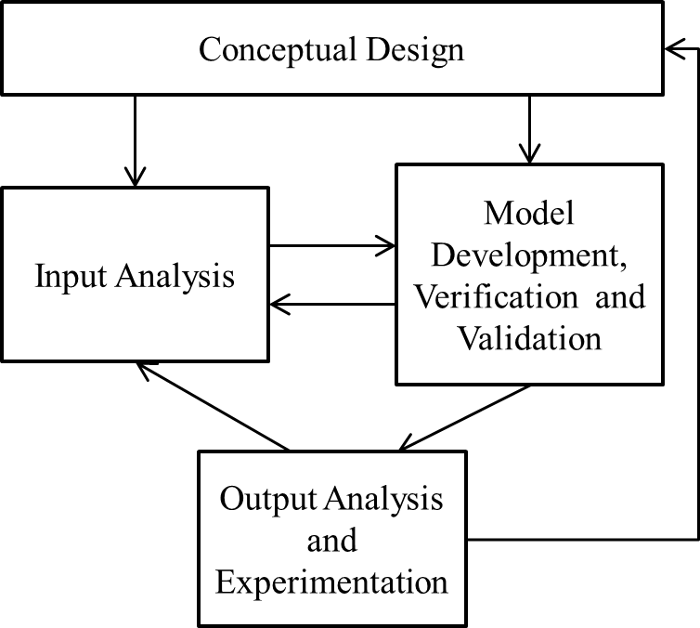
Input Analyses
Recall the simulation process:
  Input analysis is a key step!
Many systems we simulate include randomness, represented with probability distributions, and, typically, we generate values from these distributions
Two questions arise:
  How do we specify the input distributions?
  Once we know the input distributions, how do we generate values from these distributions to run the simulation model?

Slide 6
Types of Input
Deterministic vs. Stochastic
  Deterministic input are constant, stochastic input are represented with distributions
  Main question: which input should be modeled as deterministic vs. stochastic?
    More of a conceptual/design question
      Arrival times are typically random, how about scheduled arrivals? Still might include randomness
      The number of items in a shipment? Deterministic? Stochastic?
      It is important to check how sensitive the model is to the uncertainty of the specific input
        One approach: If not much, and conceptually ok, then deterministic, otherwise, stochastic
        Should match the real as much as possible
Scalar vs. Multivariate vs. Stochastic
  If an input is a single parameter, be it deterministic or stochastic, it is a scalar value
    For stochastic, also called as univariate
  Sometimes, there might be relations between different inputs
    In such a case, we should view them as components of an input vector (rather than scalars)
    If some components are random, then random vector → multivariate distribution
      For instance, processing times and inspection times can be related → if processing time is large, inspection time is expected to be large as well because the part is big

Slide 7


Types of Input
Time-Varying Arrival Rates
  In some cases, arrival rates might depend on time
    Mondays are busier than Fridays?
    During the day, traffic is denser morning/evening hours
  Analytically, nonstationary Poisson process is used to model time-varying arrival rates
    Arrival rate is a function of time t
    The number of arrivals during a time period [a,b] has a discrete Poisson dist. with mean
    How to handle that in simulation?
      One direct approach is to use piece-wise approximation
        For time intervals of a certain duration, the arrival rate is constant
        Use data, count arrivals during the duration, then average over different days/periods
  Simio supports time-varying arrival rates
    Need to specify the arrival mode of an entity to ‘Time Varying Arrival Rate’
    Then use Rate tables…

Slide 8
Outline
Input Analysis and Types of Input
Specifying Univariate Input Distributions
Distribution Fitting and Stat::Fit
Goodness of Fit and Fitting Issues
Random-Number Generators & Random Variates
Review and Simulation Experimentation Input

Slide 9
Specifying Univariate Input Distributions
How to specify the distribution of a univariate random variable for input to a simulation?
  Univariate distribution: a single (scalar) random input rather than a vectoral output
    May have many across simulation (service time, interarrival time distributions…)
    Typically it is assumed that they’re independent
      But can be dependent (a cashier seeing a long line might start working faster?)
Typically, there is real-world observed data on a simulation input
  Either available already or collected for running the simulation
  We want to fit a probability distribution to the data
  Then use this fitted distribution to generate random variates to drive the simulation

Slide 10
Specifying Univariate Input Distributions
Why not just drive simulation with actual observed data?
  Seems more direct than fitting/generating
  Useful for validation
  But there are problems:
    Run simulations for very long runs and/or many replications, so we would exhaust data fast
    Collected data will not be compherensively representative
      It only represents when the data were recorded, for instance the min and max values are just from the collected data
      So, if we only use the collected data, we rule out any other possible but unobserved value, which might have great effect on the performance of the simulated system
So, it is an important task to figure out which probability distribution best represents our collected data.

Slide 11
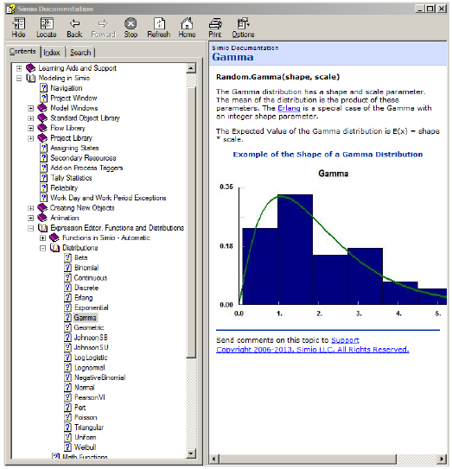
Specifying Univariate Input Distributions
There are many probability distributions; some common ones:
  Continuous: normal, exponential, continuous uniform, triangular…
  Discrete: discrete uniform, binomial, Poisson, geometric, negative binomial…
Lists of probability distributions and their properties/relationships:
  Simio supports about 20 distributions (see Help)
  Many books and web sites (e.g. http://en.wikipedia.org/wiki/List_of_probability_distributions)
  Beware: different sources may parameterize the same distribution differently, important to mesh with Simio’s definitions

Slide 12
Specifying Univariate Input Distributions
How do you choose one distribution from among hundreds?
Some qualitative criteria:
  Continuous vs. discrete inputs – choose according to situation
    For instance, batch size would be discrete while service time would be continuous
  Range (a.k.a. support) of the distribution – finite on both ends or infinite on right or left ends? Match with the real situation
  Make a histogram of the observed data, match it to shapes of known density functions (continuous) or probability mass function (discrete)
Still there might be quite a few options and, still we need to estimate distribution parameters (“fit”) and test the fit

Slide 13
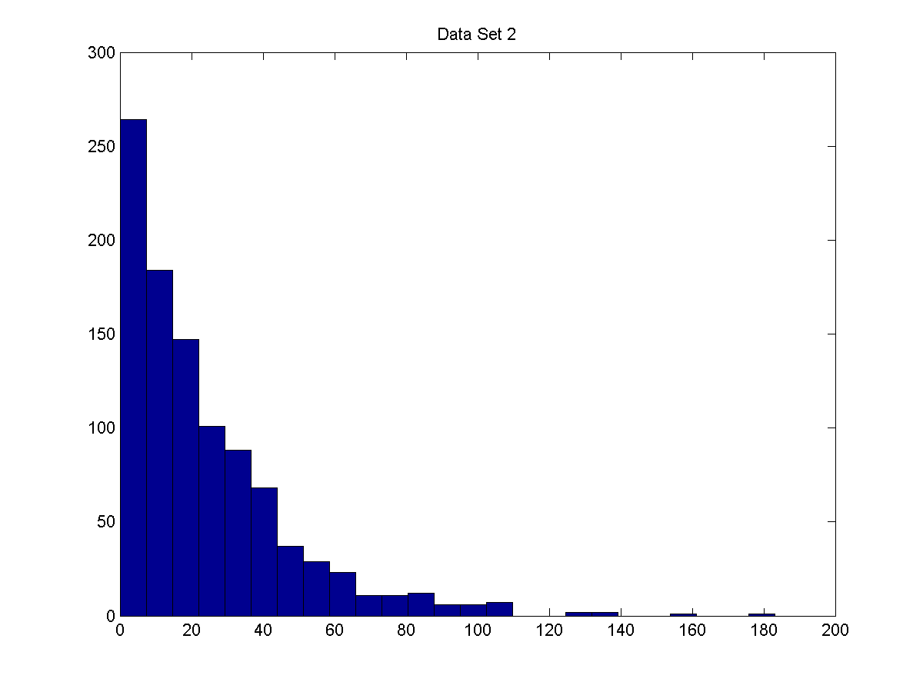
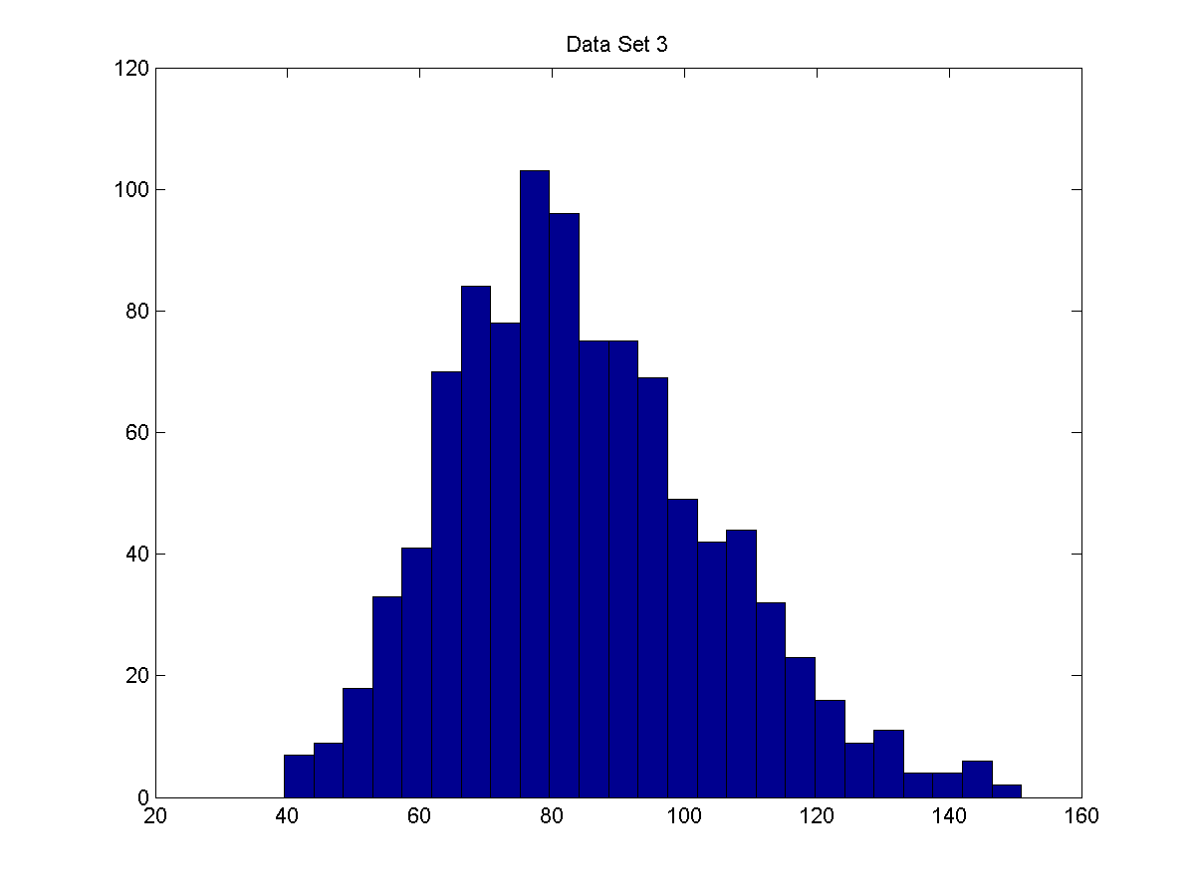
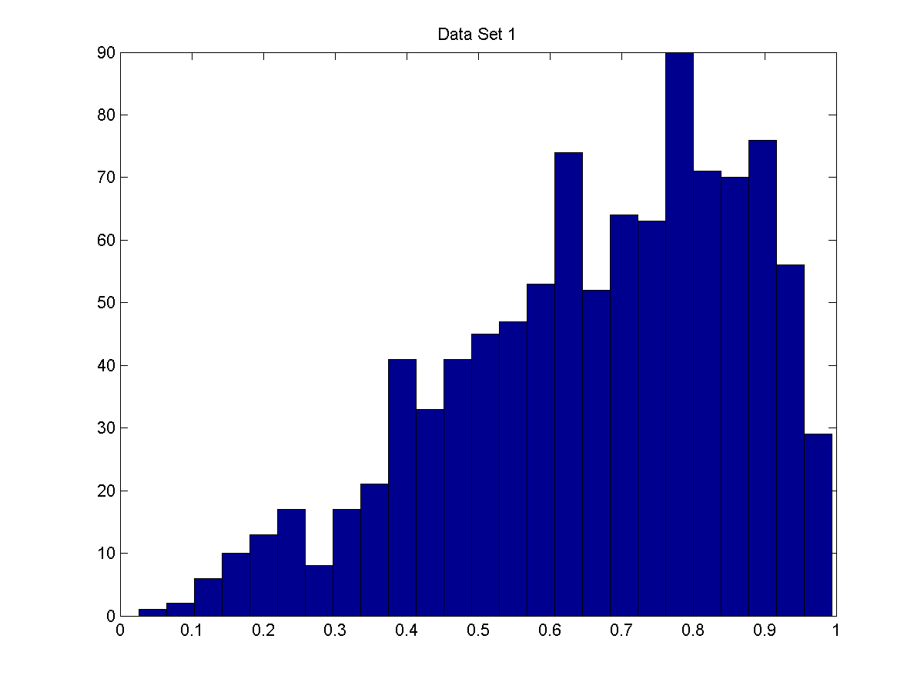
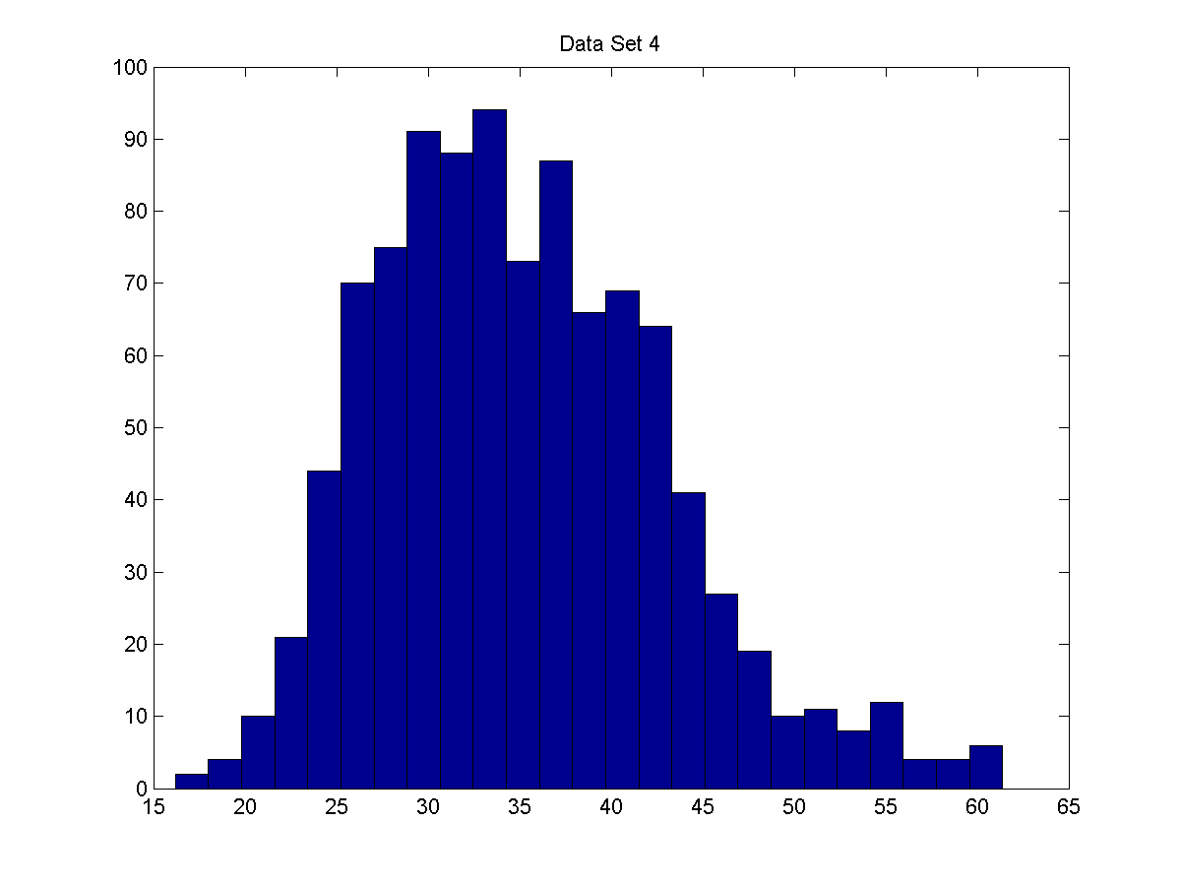
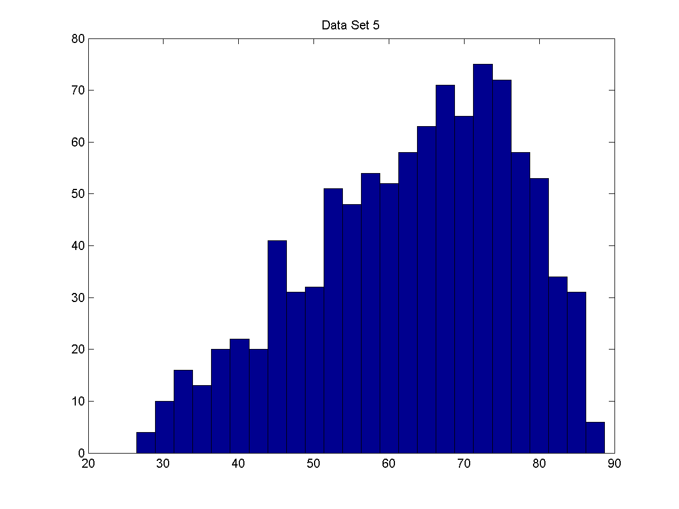
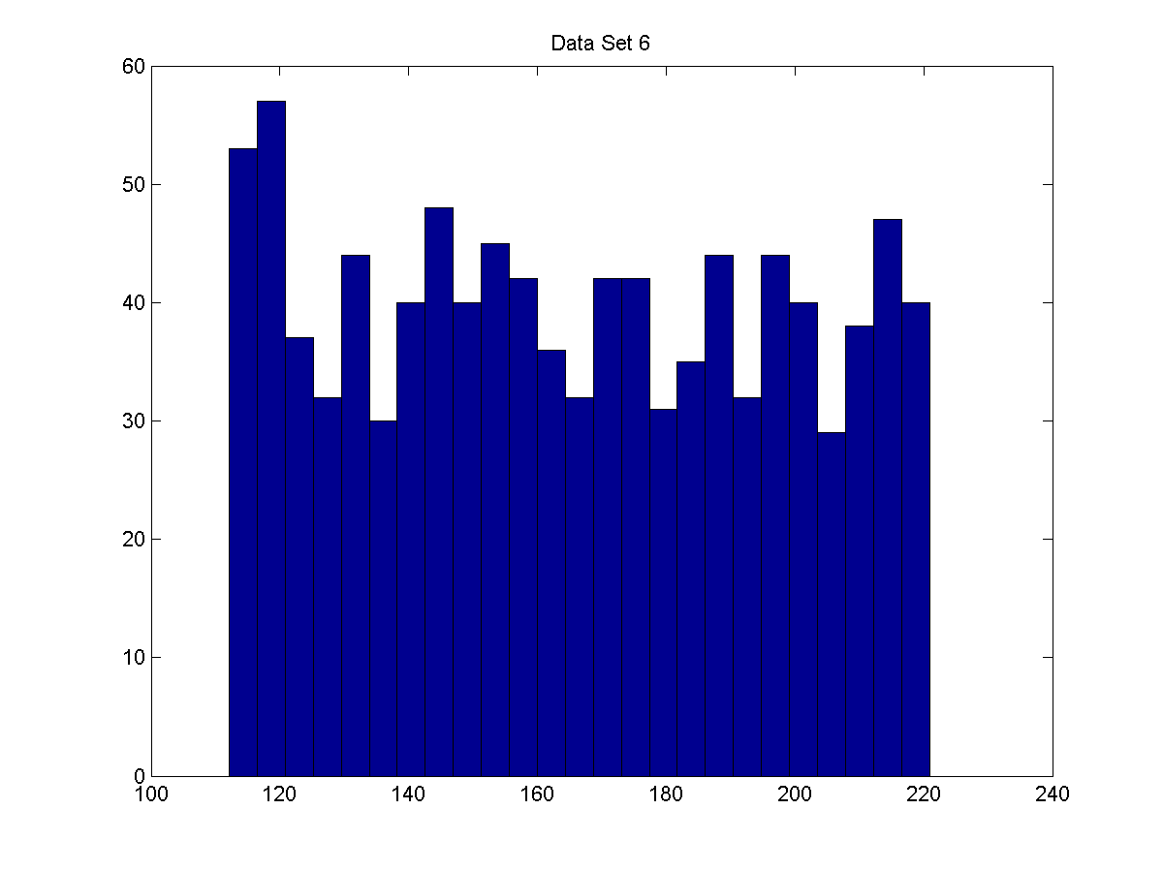
Specifying Univariate Input Distributions
How do you choose one distribution from among hundreds?
Check the histograms!

Slide 14
Specifying Univariate Input Distributions
How do you choose one distribution from among hundreds?
Have some knowledge of the distributions!
  Binomial – Models the number of successes in n trials, when the trials are independent with common success probability, p; for example; the number of defective computer chips found in a lot of n chips.
  Negative Binomial – Models the number of trials required to achieve k successes; for example, the number of computer chips that we must inspect to find 4 defective chips.
  Poisson – Models the number of independent events that occur in a fixed amount of time or space; for example, the number of customers that arrive to a store during 1 hour, or the number of defects found in 30 square meters of sheet metal.
  Normal – Models the distribution of a process that can be thought of as the sum of a number of component processes; for example, a time to assemble a product that is the sum of times required for each assembly operation.
  Lognormal – Models the distribution of a process that can be thought of as the product of a number of component processes; for example, the rate of an investment, when interest is compounded, is the product of the returns for a number of periods.

Slide 15
Specifying Univariate Input Distributions
How do you choose one distribution from among hundreds?
Have some knowledge of the distributions!
  Exponential – Models the time between independent events, or a process time that is memoryless; for example, the times between the arrivals from a large population of potential customers who act independently of each other. The exponential is a highly variable distribution; it is sometime overused because it often leads to mathematically tractable models. Recall that, if the time between events is exponentially distributed, then the number of events in a fixed period of time is Poisson.
  Gamma – An extremely flexible distribution used to model nonnegative random variables (can be shifted away from 0 by adding a constant).
  Beta – An extremely flexible distribution used to model bounded random variables. The beta can be shifted away from 0 by adding a constant and can be given a range larger than [0, 1] by multiplying by a constant.
  Erlang – Models processes that can be viewed as the sum of several exponentially distributed processes; for example, a computer network fails when a computer and two backup computers fail, and each has a TTF that is exponentially distributed.

Slide 16
Specifying Univariate Input Distributions
How do you choose one distribution from among hundreds?
Have some knowledge of the distributions!
  Weibull – Models the time to failure for components; for example, the time to failure for a disk drive. The exponential is a special case of the Weibull.
  Discrete or Continuous Uniform – Models complete uncertainty: All outcomes are equally likely. This distribution is often used inappropriately, when there are no data.
  Triangular – Models a process for which only the minimum, most likely, and maximum values of the distribution are known; for example, the minimum, most likely, and maximum time required to test a product.
  Pert – A special case of the Beta with minimum, most likely, and maximum values. The pert provides a “smooth” alternative to the triangular in the absence of data.
  Empirical – Samples from the distribution of the actual data collected; often used when no theoretical distribution seems appropriate.

Slide 17
Specifying Univariate Input Distributions
How do you choose one distribution from among hundreds?
Fitting Distributions to Observed Real-Word Data:
  Basic steps to follow:
    Select possible distribution form(s)
    Estimate parameters
    Test goodness of fit …
    Repeat as necessary …
  Some simulation software comes with this capability (but Simio does not ☹)
  But we are not hopeless, we will use Stat::Fit

Slide 18
Outline
Input Analysis and Types of Input
Specifying Univariate Input Distributions
Distribution Fitting and Stat::Fit
Goodness of Fit and Fitting Issues
Random-Number Generators & Random Variates
Review and Simulation Experimentation Input

Slide 19
Distribution Fitting and Stat::Fit
Recall the basic steps to follow for distribution fitting:
  Select possible distribution form(s)
  Estimate parameters
  Test goodness of fit …
  Repeat as necessary …
There are many possible software packages doing this
  Simulation specific packages
    Stat::Fit (www.geerms.com)
    ExpertFit (www.averill-law.com)
  General packages
      R (http://www.r-project.org/)
      EasyFit (www.mathwave.com)
      BestFit (http://www.palisade.com/)
      Matlab

Slide 20


Distribution Fitting and Stat::Fit
Start Stat::Fit
  You can copy+paste the data directly from excel (need at least 10 data points!)
    Free version is limited to 100 data points ☹
  You can draw a histogram of the data
    Go to: Input→Input Graph
    Or: click on the Input Graph button
    By default, it has 7 intervals
  You can change the number of intervals in the histogram
    Input→Options (or click on the Input Options button ), then manually enter
  You can view basic descriptive statistics of your data
    Statistics → Descriptive
      You can do more under Statistics , explore?!

Slide 21
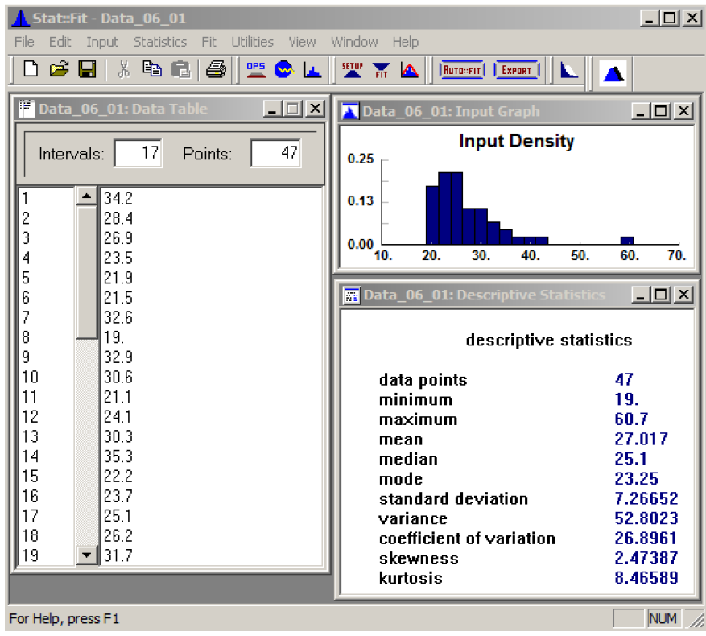
Distribution Fitting and Stat::Fit
Stat::Fit
  Histogram and descriptive statistics:

Slide 22
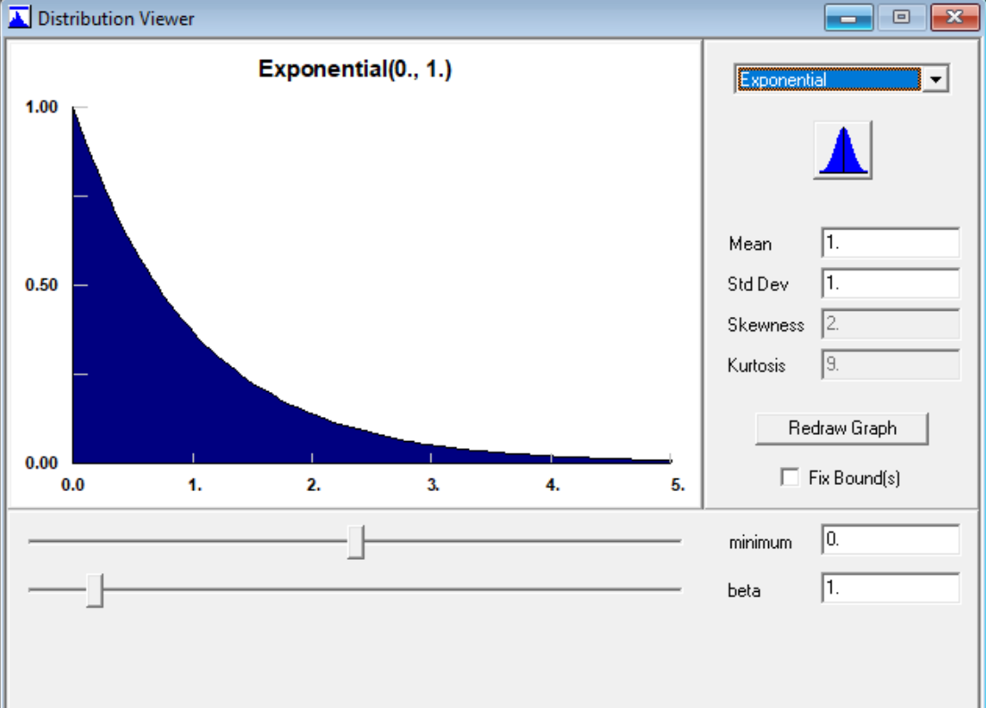
Distribution Fitting and Stat::Fit
Stat::Fit details
  Utilities → Distribution Viewer
    Views the pdf or pmf of the available distributions (free version has 7 distributions)

Slide 23
Distribution Fitting and Stat::Fit
How does Stat::Fit work?
  Let’s solve an example: Data_to_Fit.xlsx → 47 observations of service time
    Service times, so want continuous distribution, no negative values
    Stat::Fit: exponential, lognormal, normal, uniform, and triangular are possibilities
    So, we will see which ones are good fits!
  Fit → Setup, or Setup Calculations button
    Distributions tab:
      Click on desired distributions from Distribution List on left, they appear in Distributions Selected on right
    Calculations tab:
      Choices for: Estimates, Tests, Lower Bound
        Estimates: Method to estimate parameters, MLE (Maximum Likelihood) is usually best
        Tests: Different goodness-of-fit hypothesis tests, sensitive to different kinds of deviations, usually (but not always) agree
        Interval type: Active if Chi Squared test is selected; Equal Probability usually best
        Lower Bound:
          Unknown: Stat::Fit will “slide” distribution left/right to improve fit
          Fixed: Enter desired fixed lower bound in field below

Slide 24
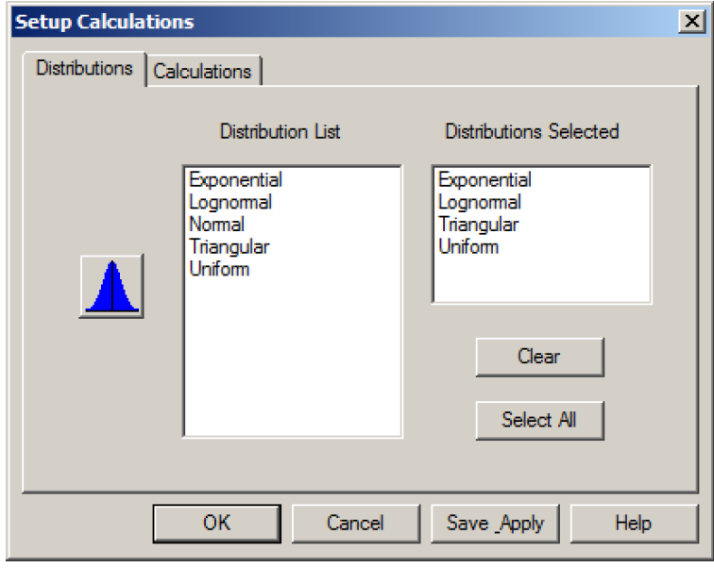
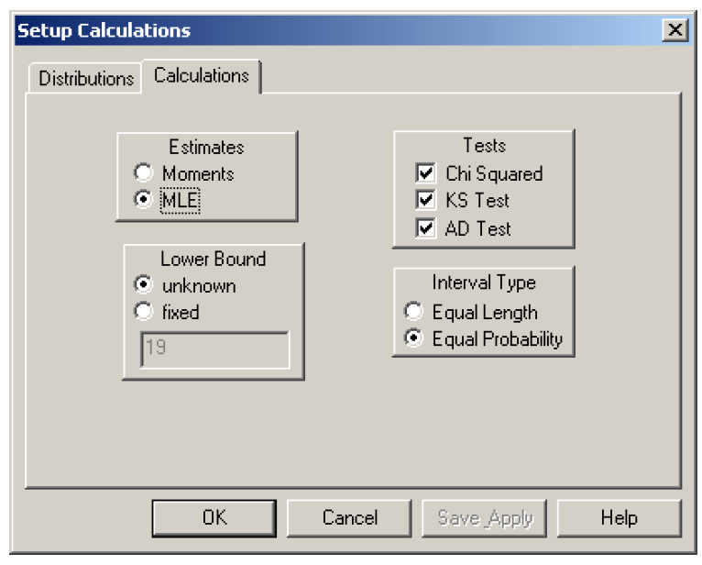
Distribution Fitting and Stat::Fit
Fit → Setup, or Setup Calculations button
  Click Save Apply, then close Setup Calculations dialog box

Slide 25
Distribution Fitting and Stat::Fit
To fit chosen distributions, Fit → Goodness of Fit, or Fit Data button
  Goodness of Fit window contains results of fits and tests
  Summary at top
Table with all distributions, all goodness-of-fit tests’ test statistics
  Smaller test statistics ⇒ better fit
  For Chi Squared test, (degrees of freedom) given
Detail report on each chosen distribution, and each goodness-of-fit test applied to it
  Most important part: p-value of the goodness-of-fit test
  “DO NOT REJECT” or “REJECT” recommendations for each test on each distribution (using p-value cutoff α in Summary at top)

Slide 26
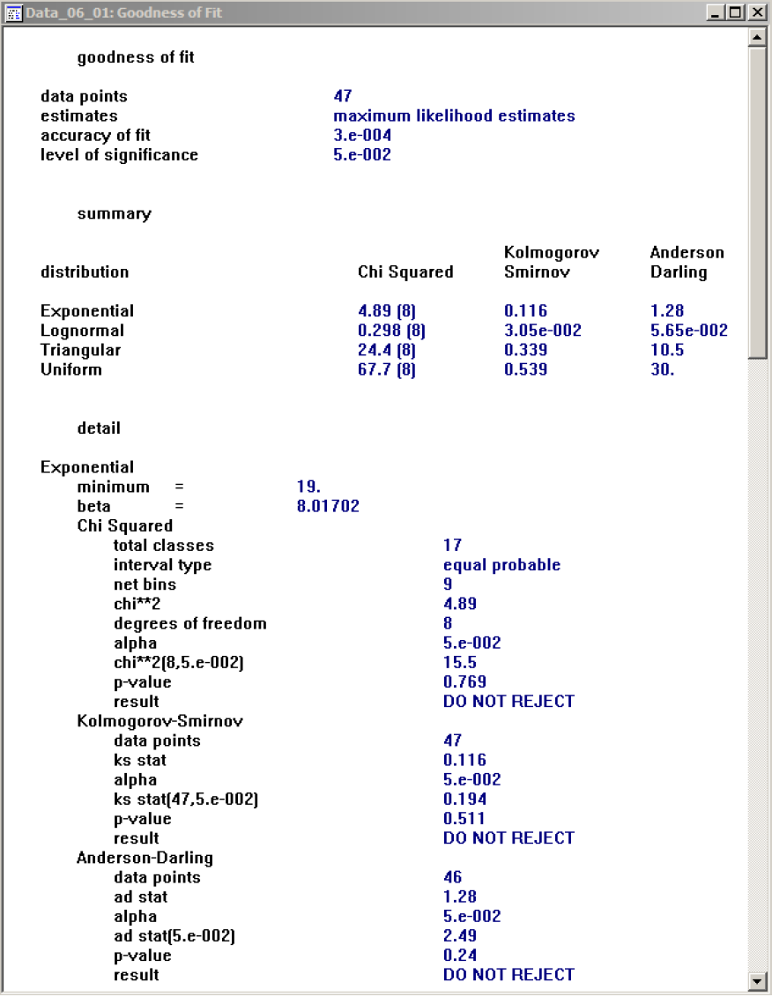
Distribution Fitting and Stat::Fit
Results report (a long report!)
  Note that distribution parameters are given under each distribution option
  p-value of the goodness-of-fit test:
    Probability of getting a test result at least as favorable to the alternate hypothesis (bad fit in this case) as the test result you actually got
    “Small” p-values (< 0.01 or 0.05, usually) indicate a poor fit
    “Large” p-values indicate no evidence of a poor fit (note that this is NOT “proof” of a good fit … just lack of evidence against this distribution)

Slide 27
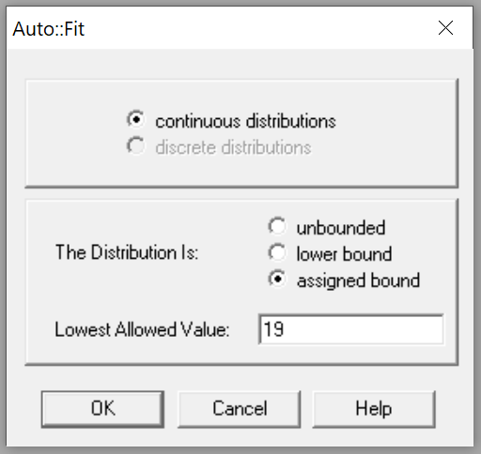
Distribution Fitting and Stat::Fit
To see fitted distributions, with parameters
  Fit → Auto::Fit, or Auto::fit button
    Select continuous or discrete (sometimes it might pre-select depending on data), and
    to manage lower bound (as before, select “lower bound” to allow Stat::Fit to choose it),
    then OK

Slide 28
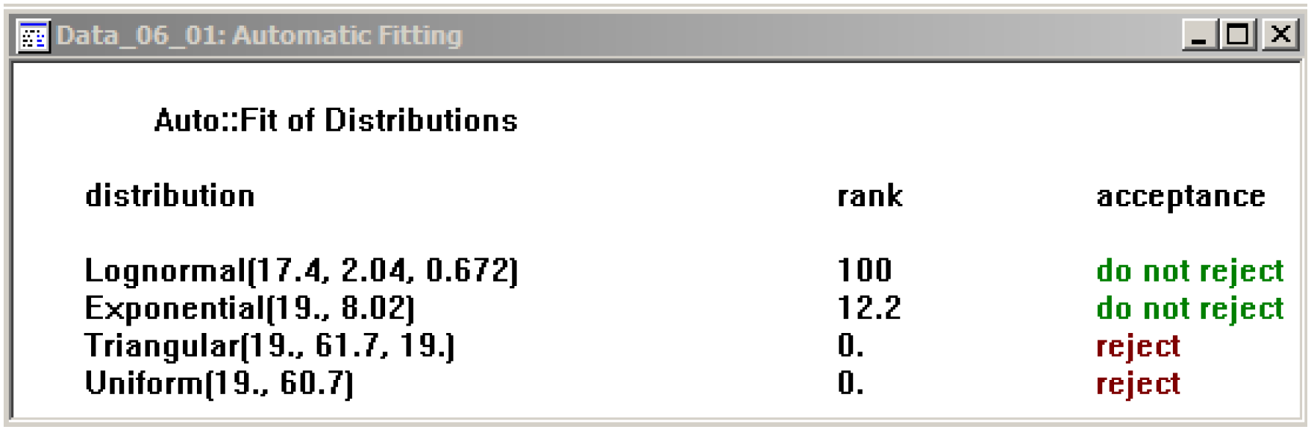
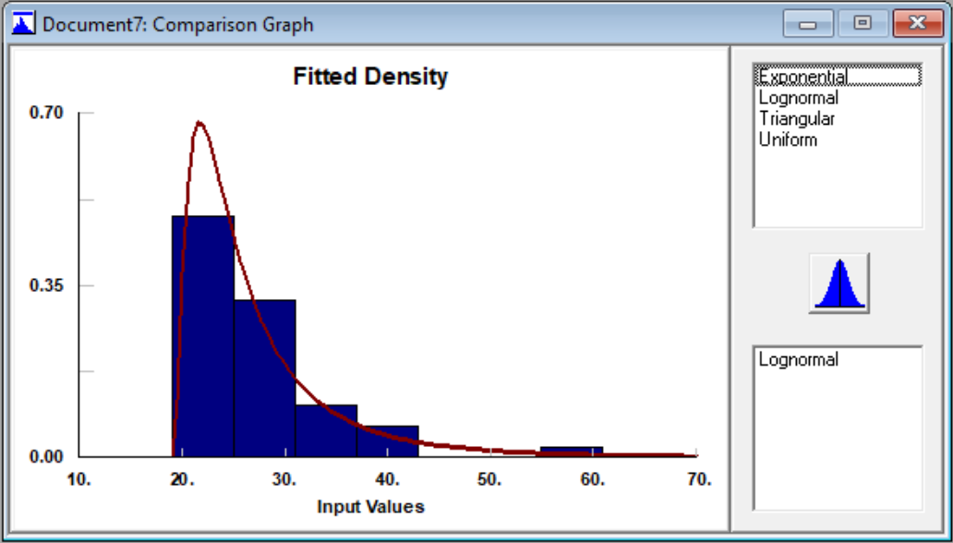
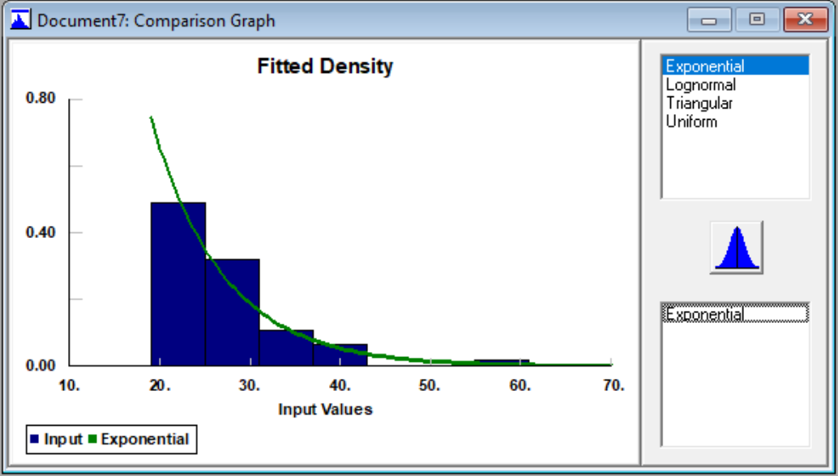
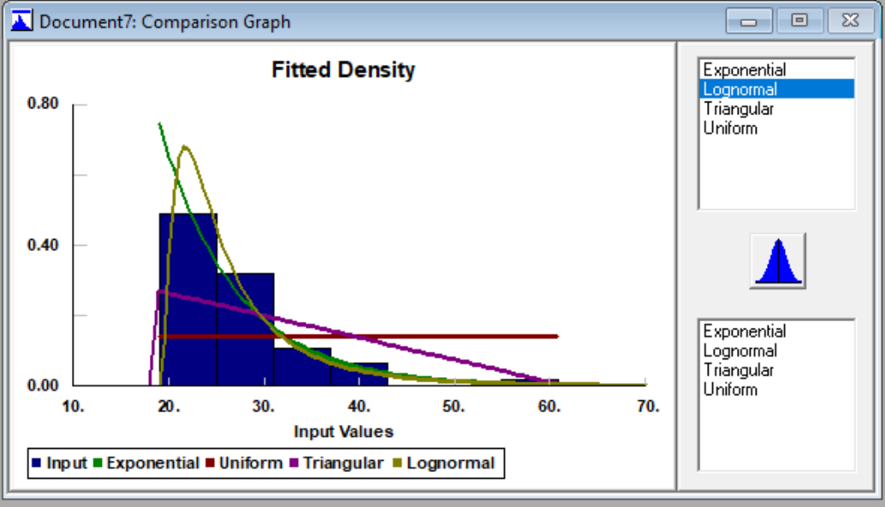
Distribution Fitting and Stat::Fit
To see fitted distributions, with parameters
  Auto::Fit results
  “Eyeball” test of fitted density over observed-data histogram (just click on a row)

Slide 29

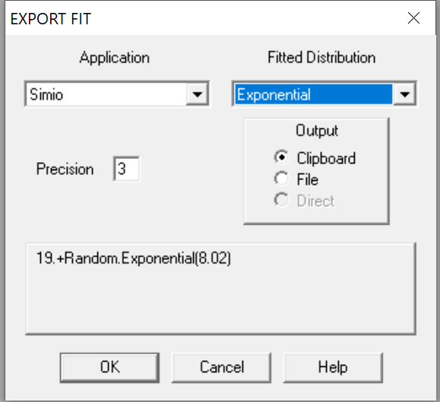
Distribution Fitting and Stat::Fit
Export to clipboard in correct Simio syntax:
  File → Export → Export Fit, or EXPORT FIT button
    Choose Simio in Application pull-down (alphabetically listed)
    Choose the distribution you want in Fitted Distribution pull-down
    Precision is number of decimal places in parameters
    “Shift” parameter in Simio syntax is added onto the front
    Can send to the Windows Clipboard or to a file
  From Clipboard can paste (CTRL-V) directly into the desired field in Simio
Can save all your Stat::Tools work in this “session” to a file
  File → Save As, choose location and filename (default extension is .sfp, for Stat::Fit Project)
  See ‘Data_Fitted.sfp’

Slide 30
Outline
Input Analysis and Types of Input
Specifying Univariate Input Distributions
Distribution Fitting and Stat::Fit
Goodness of Fit and Fitting Issues
Random-Number Generators & Random Variates
Review and Simulation Experimentation Input

Slide 31
Goodness of Fit and Fitting Issues
Assessing Goodness of Fit:
  How well the various candidate distributions do in terms of representing our data
    Measures of goodness of fit typically summarize the discrepancy between observed values and the values expected under the model in question (wikipedia)
  While using Stat:Fit, you can use three tests:
    Chi-Squared, KS (Kolmogorov-Smirnov), AD (Anderson-Darling) tests
  There are many other tests as well
    See https://en.wikipedia.org/wiki/Goodness_of_fit
  We will review:
    Chi-Squared goodness-of-fit test
    Kolmogorov-Smirnov goodness-of-fit test
    Some visual heuristics
      Q-Q plots
      P-P plots
  Chi-squared goodness-of-fit focus on comparing the fitted PDF (or PMF in the discrete case) to an empirical PDF (or PMF) (i.e., a histogram)
  Kolmogorov-Smirnov (K-S) goodness-of-fit test compared the fitted CDF to a certain empirical CDF defined directly from the data

Slide 32
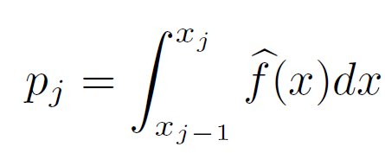
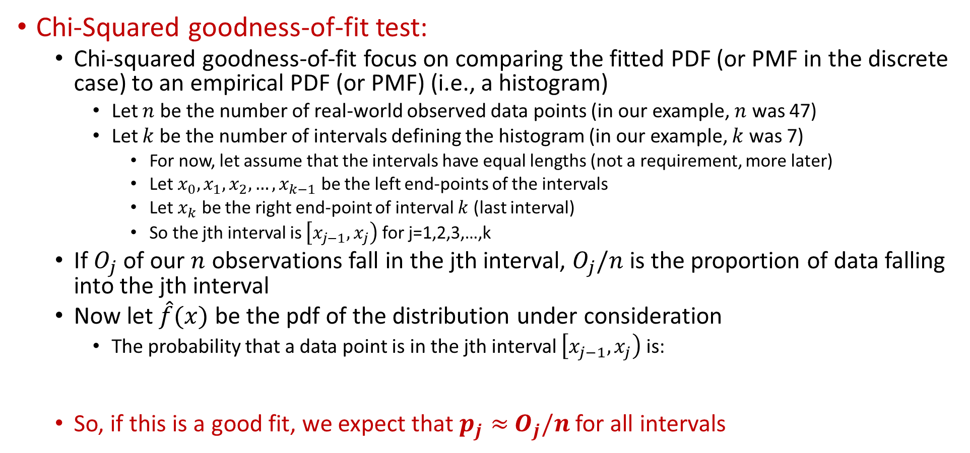
Goodness of Fit and Fitting Issues
Chi-Squared goodness-of-fit test:
  Chi-squared goodness-of-fit focus on comparing the fitted PDF (or PMF in the discrete case) to an empirical PDF (or PMF) (i.e., a histogram)
    Let $n$ be the number of real-world observed data points (in our example, $n$ was 47)
    Let $k$ be the number of intervals defining the histogram (in our example, $k$ was 7)
      For now, let assume that the intervals have equal lengths (not a requirement, more later)
      Let $x_{0}, x_{1}, x_{2},…, x_{k−1}$ be the left end-points of the intervals
      Let $x_{k}$ be the right end-point of interval $k$ (last interval)
      So the jth interval is $\left[x_{j−1},x_{j}\right)$ for j=1,2,3,…,k
  If $O_{j}$ of our $n$ observations fall in the jth interval, $O_{j}/n$ is the proportion of data falling into the jth interval
  Now let $\hat{f}(x)$ be the pdf of the distribution under consideration
    The probability that a data point is in the jth interval $\left[x_{j−1},x_{j}\right)$ is:
  So, if this is a good fit, we expect that $p_{j}≈$ $O_{j}/n$ for all intervals

Slide 33
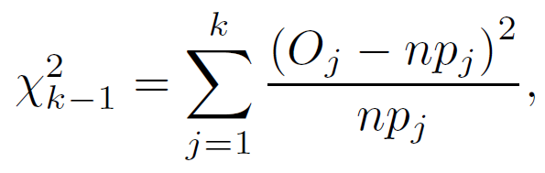



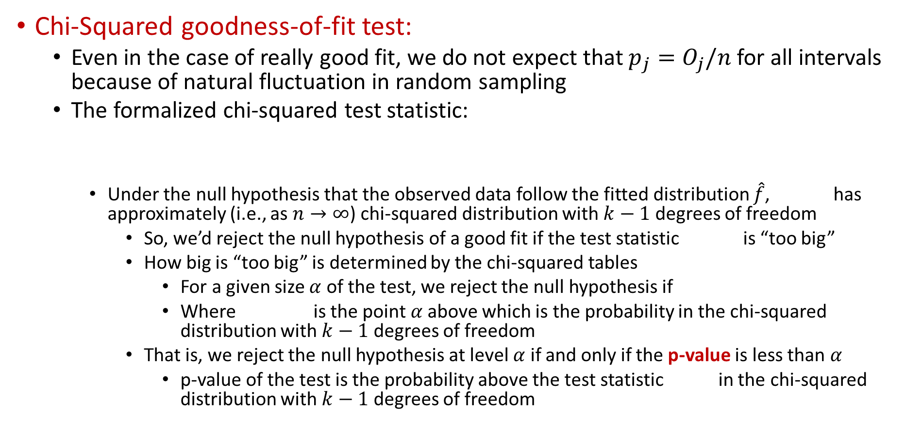
Goodness of Fit and Fitting Issues
Chi-Squared goodness-of-fit test:
  Even in the case of really good fit, we do not expect that $p_{j}=$ $O_{j}/n$ for all intervals because of natural fluctuation in random sampling
  The formalized chi-squared test statistic:
    Under the null hypothesis that the observed data follow the fitted distribution $\hat{f}$, has approximately (i.e., as $n→∞$) chi-squared distribution with $k−1$ degrees of freedom
      So, we’d reject the null hypothesis of a good fit if the test statistic is “too big”
      How big is “too big” is determined by the chi-squared tables
        For a given size $α$ of the test, we reject the null hypothesis if
        Where is the point $α$above which is the probability in the chi-squared distribution with $k−1$ degrees of freedom
      That is, we reject the null hypothesis at level $α$ if and only if the p-value is less than $α$
        p-value of the test is the probability above the test statistic in the chi-squared distribution with $k−1$ degrees of freedom

Slide 34


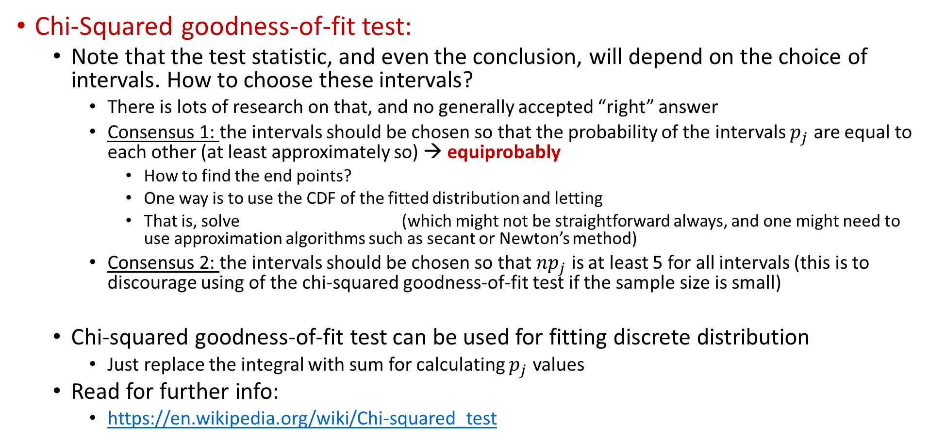
Goodness of Fit and Fitting Issues
Chi-Squared goodness-of-fit test:
  Note that the test statistic, and even the conclusion, will depend on the choice of intervals. How to choose these intervals?
    There is lots of research on that, and no generally accepted “right” answer
    Consensus 1: the intervals should be chosen so that the probability of the intervals $p_{j}$ are equal to each other (at least approximately so) → equiprobably
      How to find the end points?
      One way is to use the CDF of the fitted distribution and letting
      That is, solve (which might not be straightforward always, and one might need to use approximation algorithms such as secant or Newton’s method)
    Consensus 2: the intervals should be chosen so that ${np}_{j}$ is at least 5 for all intervals (this is to discourage using of the chi-squared goodness-of-fit test if the sample size is small)
  Chi-squared goodness-of-fit test can be used for fitting discrete distribution
    Just replace the integral with sum for calculating $p_{j}$ values
  Read for further info:
    https://en.wikipedia.org/wiki/Chi-squared_test

Slide 35
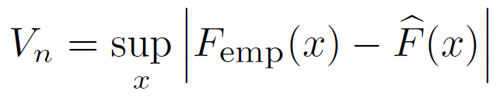
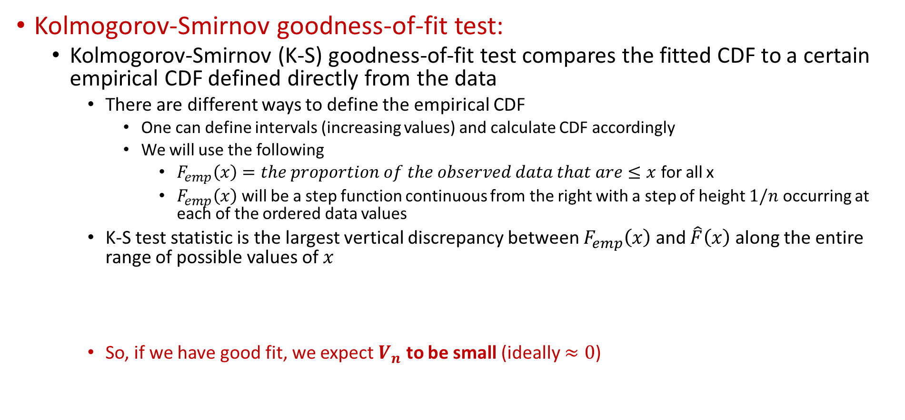
Goodness of Fit and Fitting Issues
Kolmogorov-Smirnov goodness-of-fit test:
  Kolmogorov-Smirnov (K-S) goodness-of-fit test compares the fitted CDF to a certain empirical CDF defined directly from the data
    There are different ways to define the empirical CDF
      One can define intervals (increasing values) and calculate CDF accordingly
      We will use the following
        $F_{emp}\left(x\right)=the proportion of the observed data that are≤x$ for all x
        $F_{emp}\left(x\right)$ will be a step function continuous from the right with a step of height $1/n$ occurring at each of the ordered data values
    K-S test statistic is the largest vertical discrepancy between $F_{emp}\left(x\right)$ and $\hat{F}\left(x\right)$ along the entire range of possible values of $x$
    So, if we have good fit, we expect $V_{n}$ to be small (ideally $≈0$)

Slide 36
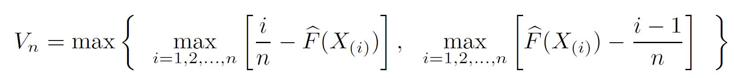
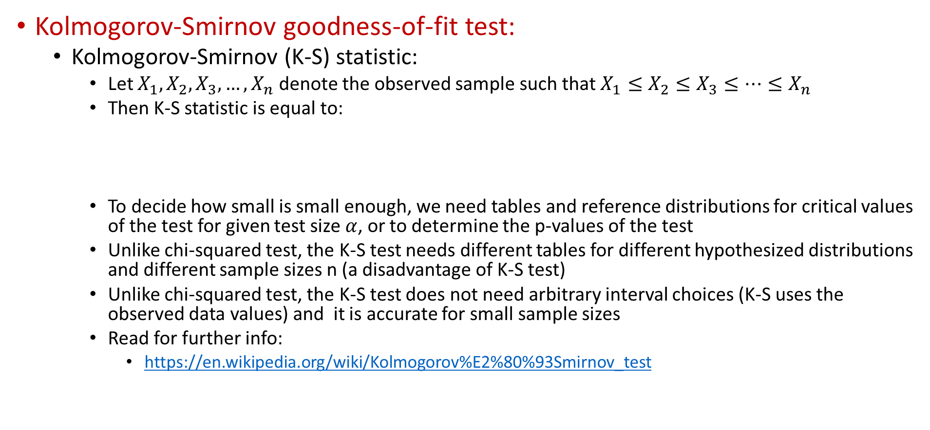
Goodness of Fit and Fitting Issues
Kolmogorov-Smirnov goodness-of-fit test:
  Kolmogorov-Smirnov (K-S) statistic:
    Let $X_{1}, X_{2},X_{3},…, X_{n}$ denote the observed sample such that $X_{1}≤X_{2}≤X_{3}≤…≤X_{n}$
    Then K-S statistic is equal to:
    To decide how small is small enough, we need tables and reference distributions for critical values of the test for given test size $α$, or to determine the p-values of the test
    Unlike chi-squared test, the K-S test needs different tables for different hypothesized distributions and different sample sizes n (a disadvantage of K-S test)
    Unlike chi-squared test, the K-S test does not need arbitrary interval choices (K-S uses the observed data values) and it is accurate for small sample sizes
    Read for further info:
      https://en.wikipedia.org/wiki/Kolmogorov%E2%80%93Smirnov_test

Slide 37

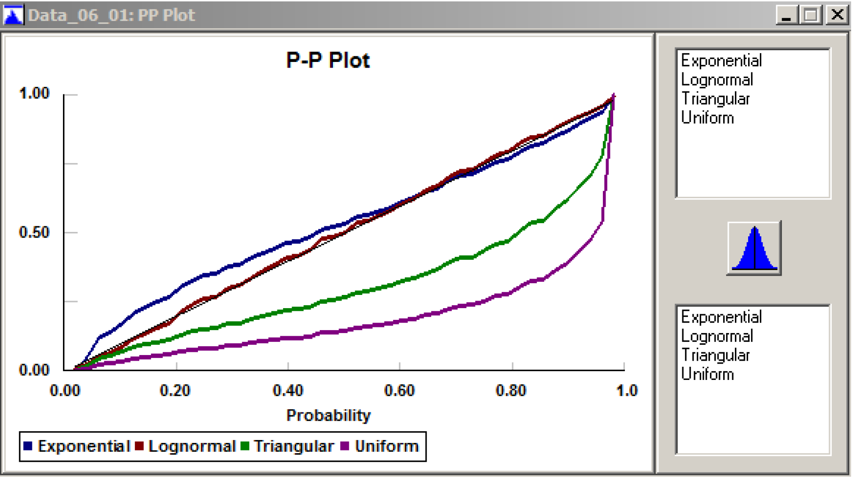
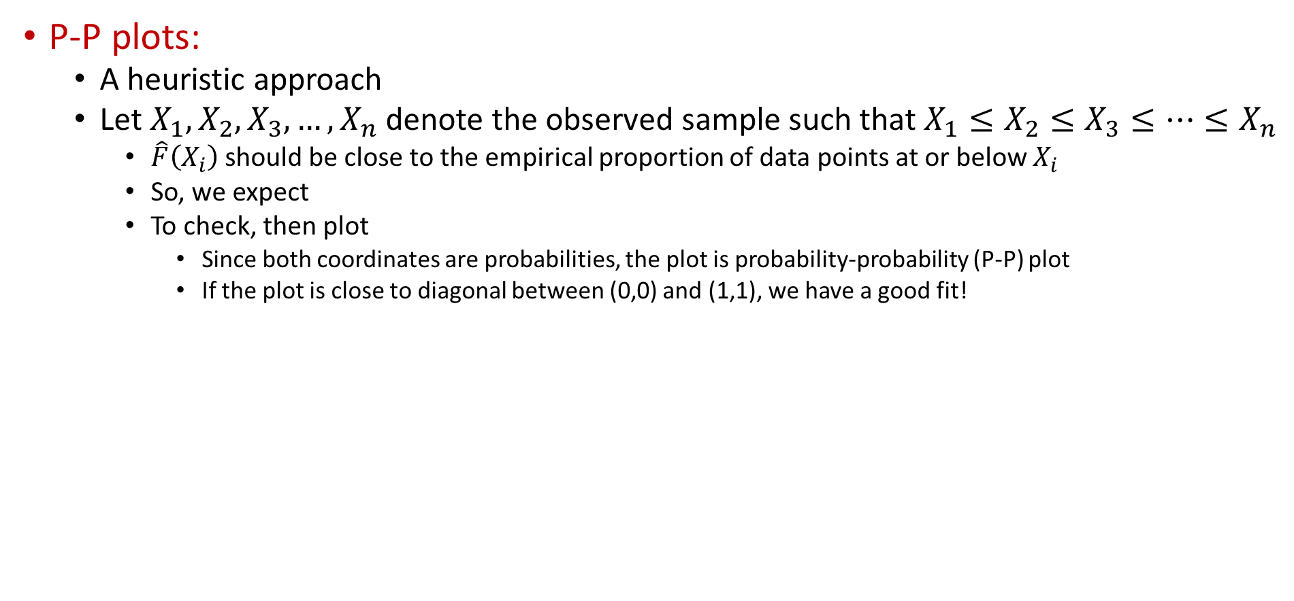
Goodness of Fit and Fitting Issues
P-P plots:
  A heuristic approach
  Let $X_{1}, X_{2},X_{3},…, X_{n}$ denote the observed sample such that $X_{1}≤X_{2}≤X_{3}≤…≤X_{n}$
    $\hat{F}\left(X_{i}\right)$ should be close to the empirical proportion of data points at or below $X_{i}$
    So, we expect
    To check, then plot
      Since both coordinates are probabilities, the plot is probability-probability (P-P) plot
      If the plot is close to diagonal between (0,0) and (1,1), we have a good fit!
In Stat::Fit
Fit→Result Graphs→PP Plot

Slide 38

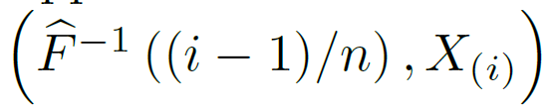
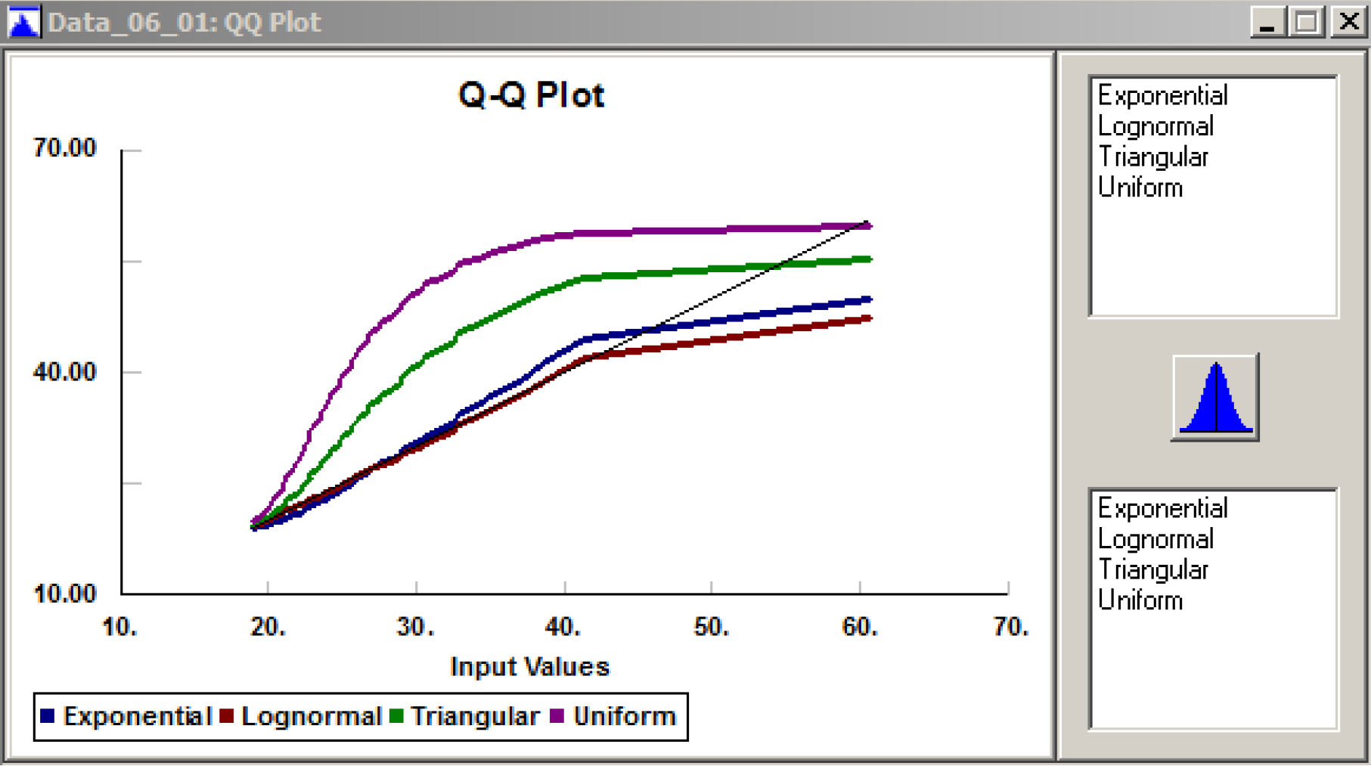

Goodness of Fit and Fitting Issues
Q-Q plots:
  A heuristic approach, similar to P-P plots
  Let $X_{1}, X_{2},X_{3},…, X_{n}$ denote the observed sample such that $X_{1}≤X_{2}≤X_{3}≤…≤X_{n}$
    If $\hat{F}\left(x\right)$ is good fit, we expect
    We plot the points
      Since both coordinates are quantiles, the plot is quantile-quantile (Q-Q) plot
      If the plot is close to diagonal between $\left(X_{1},X_{1}\right)$and $\left(X_{n},X_{n}\right)$we have a good fit!
In Stat::Fit
Fit→Result Graphs→QQ Plot

Slide 39
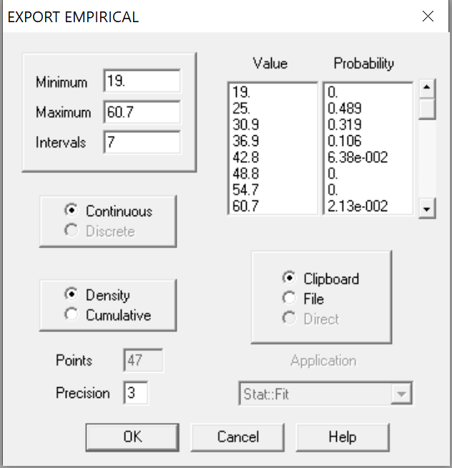
Goodness of Fit and Fitting Issues
Distribution Fitting Issues:
  What if nothing fits?
    We can use empirical distribution in most Simulation packages, Simio allows that
      Random.Discrete(v1, c1, v2, c2, …)
      Random.Continuous(v1, c1, v2, c2, …)
      Simio will connect the dots and can generate random draws accordingly (depending on discrete or continuous)
      In either case, it is assumed that the support is a bounded range, i.e., finite lower and upper values (min and max from the data)
    Stat::Fit can produce this
      File→Export→Export Empirical
      Select Cumulative rather than density for Simio
      Will copy onto Windows clipboard a sequence of vi ci values, vi→value, ci→ cumulative probability at vi

Slide 40
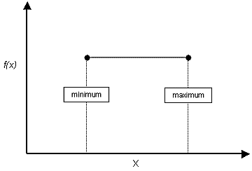
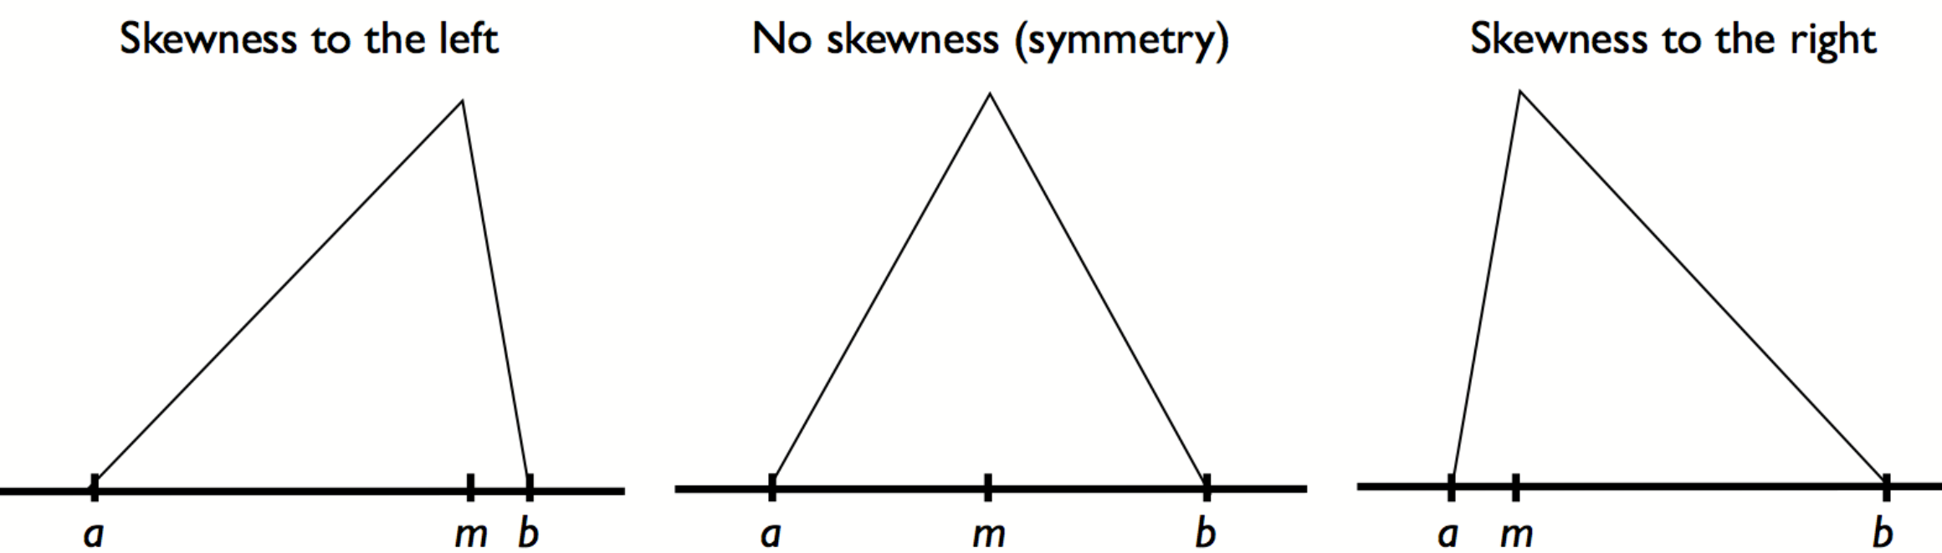
Goodness of Fit and Fitting Issues
Distribution Fitting Issues:
  No data?
    Estimate, then test
    Ask experts about a lower and upper limit (which define a uniform distribution already)
    If uniform is weighing the ends too much, maybe use a triangular distribution
      Dincer Konur and Mihalis Golias. 2013. Cost-stable truck scheduling at a cross-dock facility with unknown truck arrivals: A meta-heuristic approach. Transportation Research Part E.
        Trucks arrive at cross-dock facility, we do know the time-window, but not sure about the distribution within the time window, we used different triangular distributions to model early, on-time, and late arrival behaviors

Slide 41
Goodness of Fit and Fitting Issues
Distribution Fitting Issues:
  Too much data?
    “False” rejection → more likely to reject distributions
    Right amount of data?
      No global answer to this
      Build your model, with some distributions, to see how sensitive you’re the key things you want to evaluate to a specific distribution
      If too sensitive, then collect more data, make rigorous analyses on that specific input!
What is the right answer?
  Distribution fitting is subject to statistical error!
    Different tests might indicate different distributions
    Or different distributions might have the same goodness of fit
    Consider secondary criteria
      Ease of manipulation of the distributions, maybe, so that you make things easier test with simulation

Slide 42
Outline
Input Analysis and Types of Input
Specifying Univariate Input Distributions
Distribution Fitting and Stat::Fit
Goodness of Fit and Fitting Issues
Random-Number Generators & Random Variates
Review and Simulation Experimentation Input

Slide 43
Random-Number Generators & Random Variates
Random-Number-Generator:
  Once we characterize the stochastic input to our simulation model, to run it, we need to generate random numbers from the specified distributions
  Every simulation model with stochastic input must start with generating random numbers
    What we mean by random numbers here is “observations uniformly and continuous distribution between 0 and 1”
      We will use those to generate draws from other distributions later
    Generating really random numbers is impossible (still an open problem)
    There are algorithms that generate values that appear random (pseudo-random)
    These algorithms are known as random-number-generators (RNGs)
      Developing RNGs is technically challenging

Slide 44
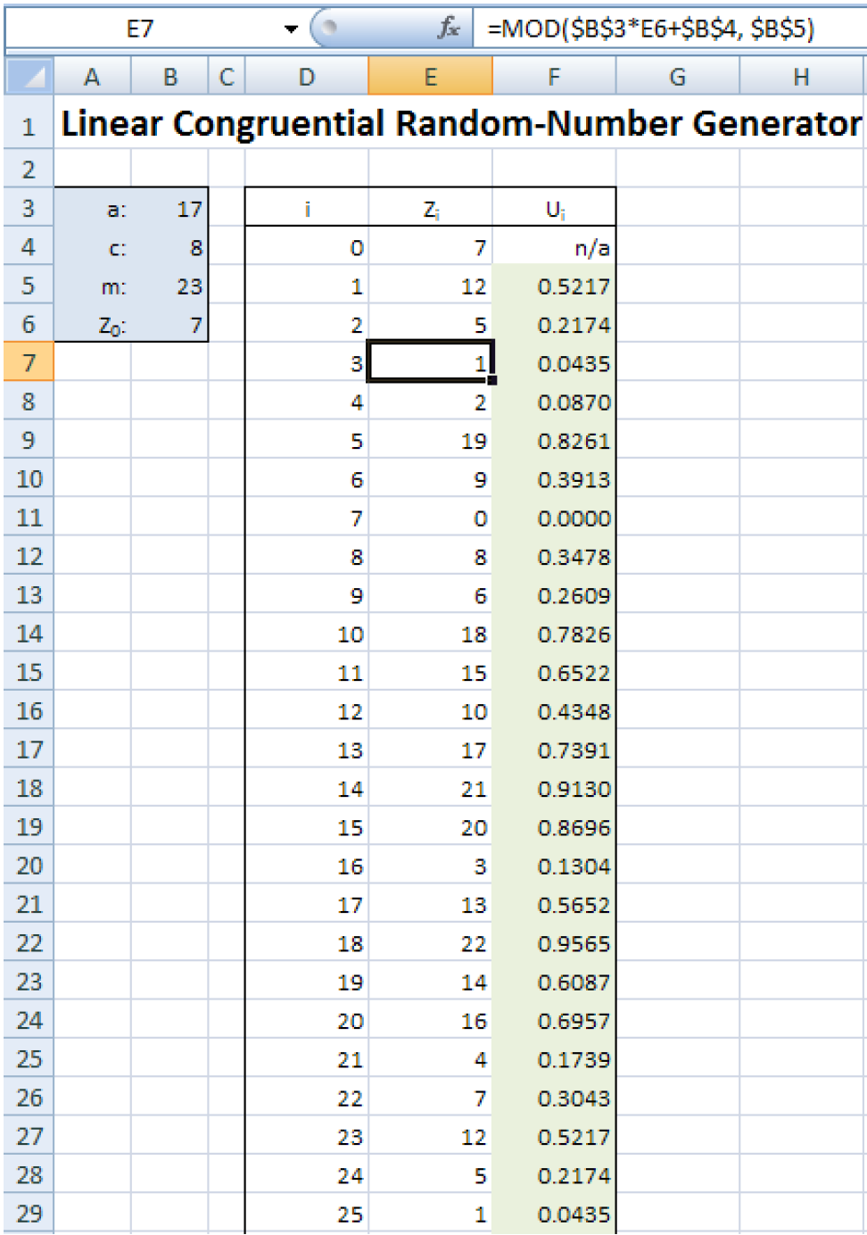



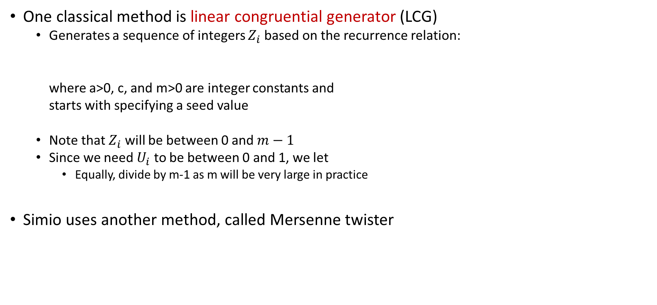
Random-Number Generators & Random Variates
One classical method is linear congruential generator (LCG)
  Generates a sequence of integers $Z_{i}$ based on the recurrence relation:
  where a>0, c, and m>0 are integer constants and
  starts with specifying a seed value
  Note that $Z_{i}$ will be between 0 and $m−1$
  Since we need $U_{i}$ to be between 0 and 1, we let
    Equally, divide by m-1 as m will be very large in practice
Simio uses another method, called Mersenne twister
See ‘Model_LCG.xlsx’ for the excel file.

Slide 45


Random-Number Generators & Random Variates
Random-variate-generation:
  We know how to generate random numbers from uniform distribution between 0 and 1 using random-number-generators (RNGs)
  Using RNGs, the process of generating random numbers from other distributions is called random-variate-generation
    Simio takes care of random-variate-generation for us
  We will discuss the very basics of random-variate-generation
    A basic principle is to use the cumulative distribution function CDF, F(x)
      Generate a random number U between 0 and 1
      Try to solve for F(x)=U → x is the random draw from the specified distribution
      Solving F(x)=U →

Slide 46
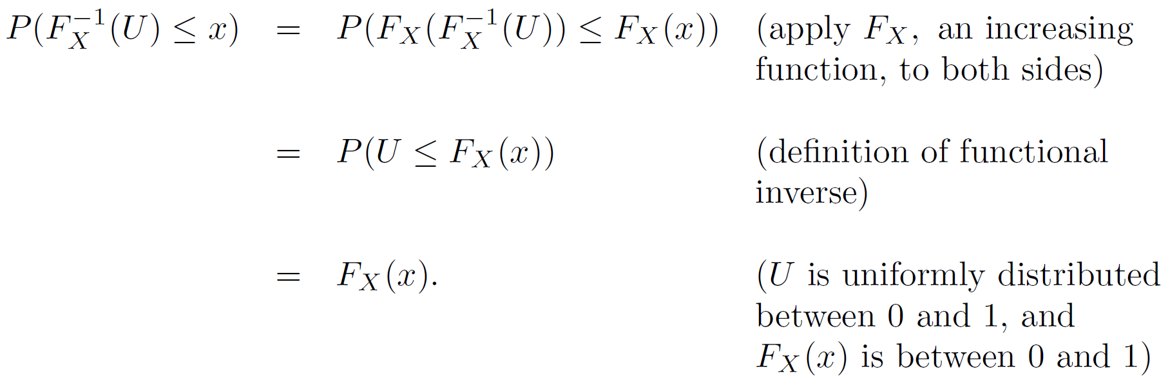
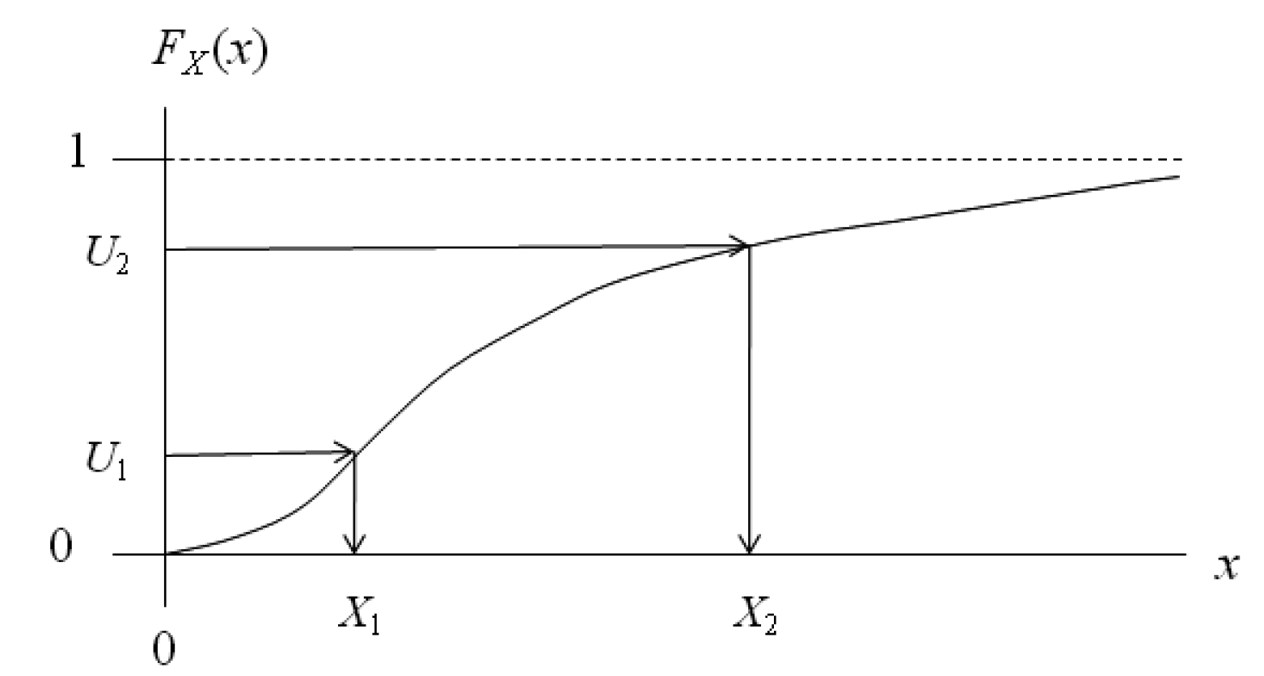
Random-Number Generators & Random Variates
Random-variate-generation:
  A basic principle is to use the cumulative distribution function CDF, F(x)
    Why does it work?

Slide 47
Outline
Input Analysis and Types of Input
Specifying Univariate Input Distributions
Distribution Fitting and Stat::Fit
Goodness of Fit and Fitting Issues
Random-Number Generators & Random Variates
Review and Simulation Experimentation Input

Slide 48
Review
Input analysis has two main goals:
  Characterize the input
  Develop methods to generate random draws for stochastic input
Characterizing the input:
  Input types: deterministic vs. stochastic, scalar vs. multivariate vs. univariate
  Distribution fitting
    Qualitative analysis
    Quantitative analyses, goodness of fit, fitting issues
    Stat::Fit
      QQ plots, PP plots, there is also box-plot
Methods to generate random observations:
  Random number generators and random variates
  Read SS Chapter 6.3-6.4 and 6.5

Slide 49
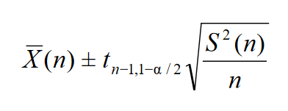
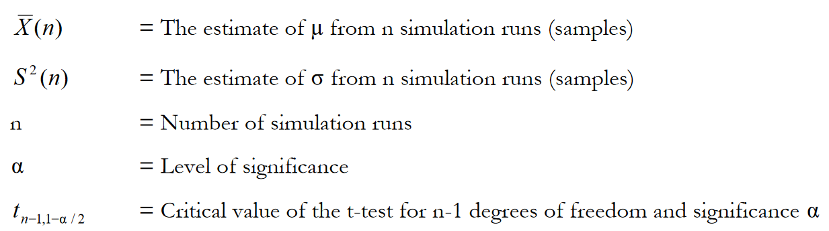
Simulation Experimentation Input
In addition to input about the system, we need to also give input to the experimental design
  How long should the warm-up period be?
    Not a direct answer, observe the output statistic over time, plot it, and see if it is appearing stable
  How many replications we should run?
    Depends on the confidence interval
    Recall that we talked about half-width
    For n replications,

Slide 50
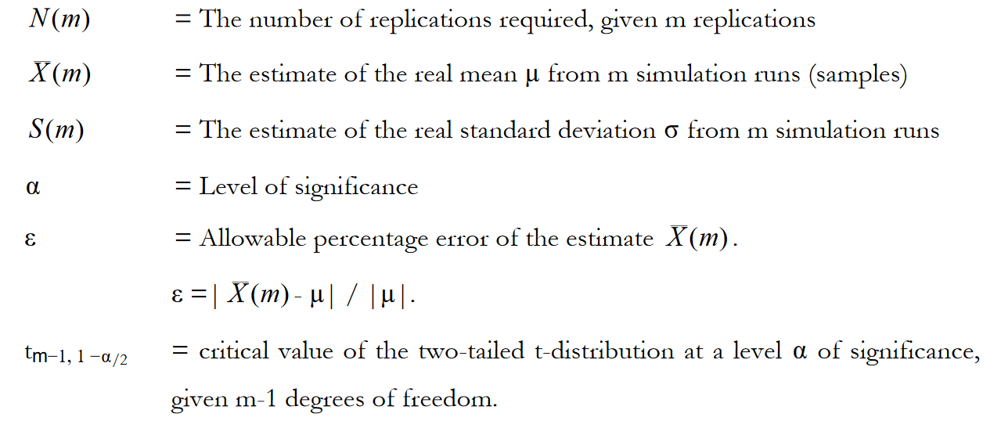
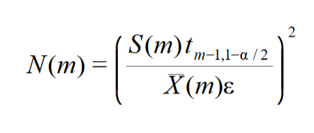
Simulation Experimentation Input
In addition to input about the system, we need to also give input to the experimental design
  How many replications we should run?
    The required number of replications for a specific level of confidence, given m initial replications:

Slide 51
Simulation Experimentation Input
In addition to input about the system, we need to also give input to the experimental design
  How long we should run the simulation (one replication)?
    We want to make sure that we have enough draws from each stochastic input
    So, we can simply use the number of draws needed similar to the number of replications from each stochastic input → like, you need 1000 interarrivals
    Then you can calculate the run length
Remarks:
  We can use distribution fitting methods for understanding the behavior of the output
    Because our simulation run will return observations!
  Do not forget, simulation results are subject to statistical errors due to sampling!

